Slide 1
Hackathon Project : POTENTIAL PHYSICIANS FOR MARKETING ON SOCIAL MEDIA
Presented By
Abu Ibne Bayazid

Slide 2


MOTIVATION:
We are connected through social media
Medicine in the Age of Twitter - The New York Times
Statistics on How Social Media Is Changing the Healthcare Industry
33% of U.S. consumers use social media for healthcare information.
(source: Search Engine Watch)
60% of doctors say social media improve the quality of care delivered
to patients. (source: Demi & Cooper Advertising and DC Interactive Group)
Social media sites are increasingly implementing marketing-friendly strategies,
creating platforms that are mutually beneficial for users, businesses,
and the networks themselves

Slide 3
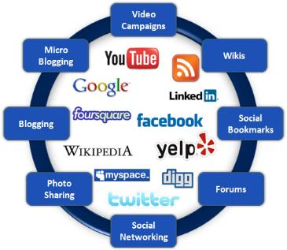





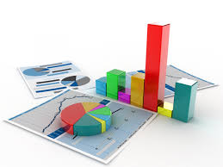
IDEA OVERVIEW:
Extract Data and Processing
User
Social Media
BI Report
Prepare Core DataMart
Social Media

Slide 4
OUTCOMES AND BUSINESS VALUE:
Outcomes
Prepare a central data warehouse based on the activity of physicians on diffident platform
Follow Physician’s activity on social media over the period of time
Prepare an analytics platform to analyze physicians data from different perspective (individual, country, platform, activity status) to identify their interest
Business Value
This can be an important data source for any company who works with healthcare data.
This can facilities clients to promote their products in Social Media in a efficient manner.
It will save time to introduce a products (Drugs & Medical equipment) among the Physicians
This can be an Above The Line(ATL) marketing approach

Slide 5




TECHNIQUES AND TOOLS:
Techniques
Social network analysis
Dimensional modeling
Text Analysis
Tools
Twitter API
R and its packages
Power BI
MongoDB

Slide 6
PROCESS FLOW OF THE PROTOTYPE
Extract Data
Extract account details from social media (e.g. Twitter) using R.
Search criteria on name: ‘Dr’
Extract Tweets of all accounts in the initial base using R.
Max Tweets around 3200
Extract follower list of all accounts in the initial base using R.
Load and Transform
Transform data into dimensional model
Load data to database
Dashboard and Analysis
Prepare dashboard using Power BI

Slide 7
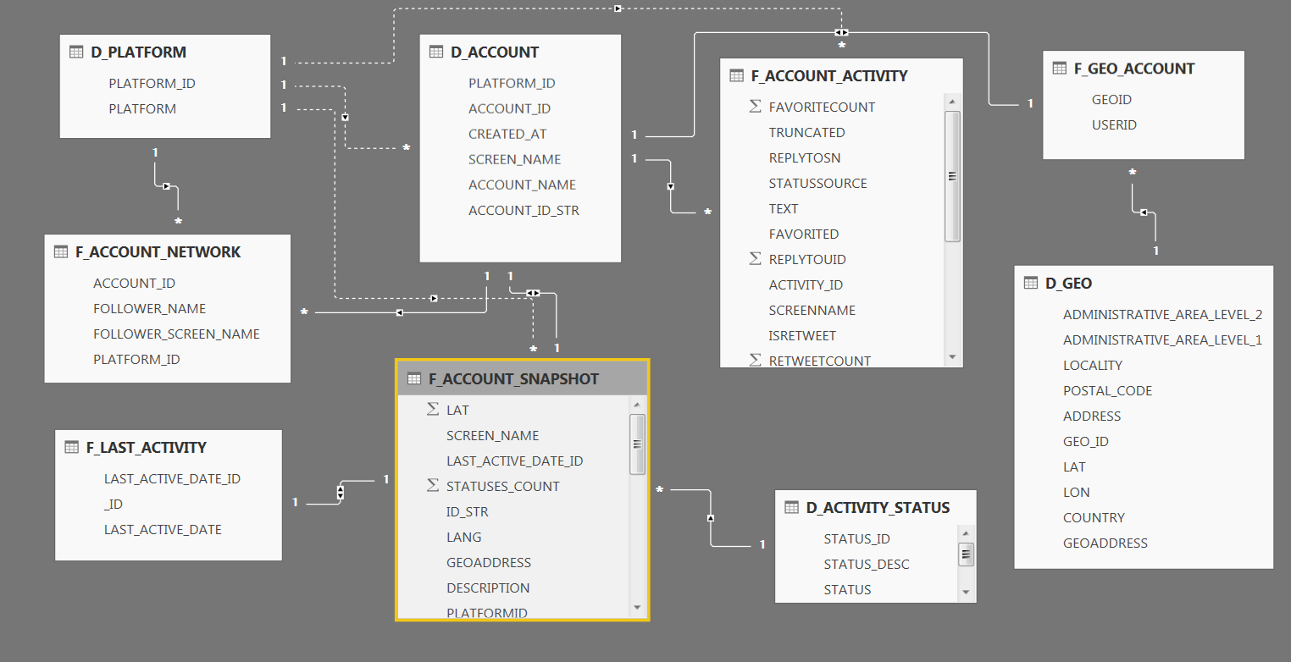
DIMENSIONAL MODEL:

Slide 8
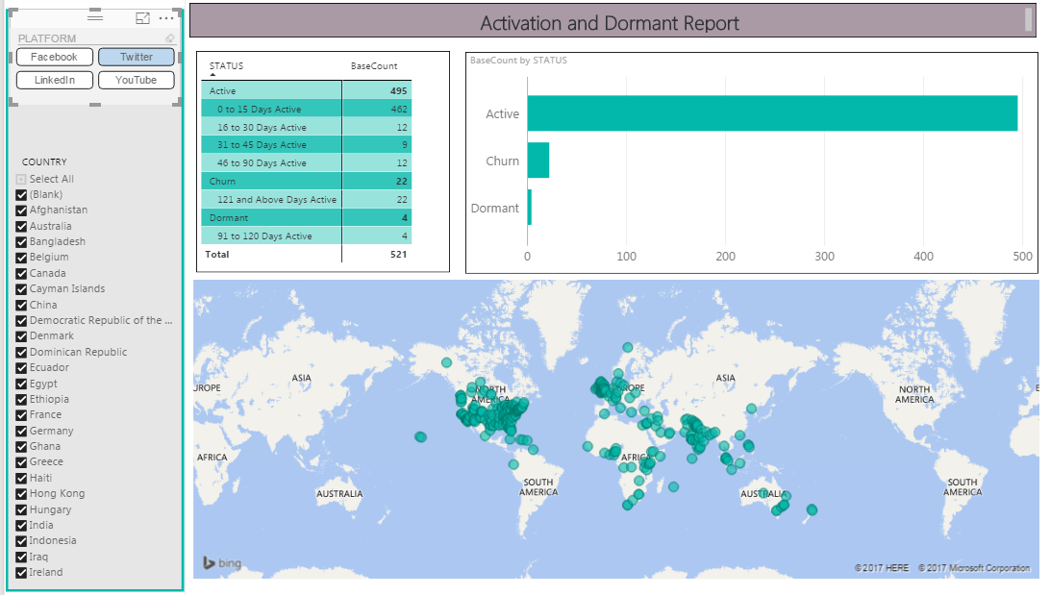
SAMPLE REPORT: ACTIVATION AND DORMANT REPORT

Slide 9
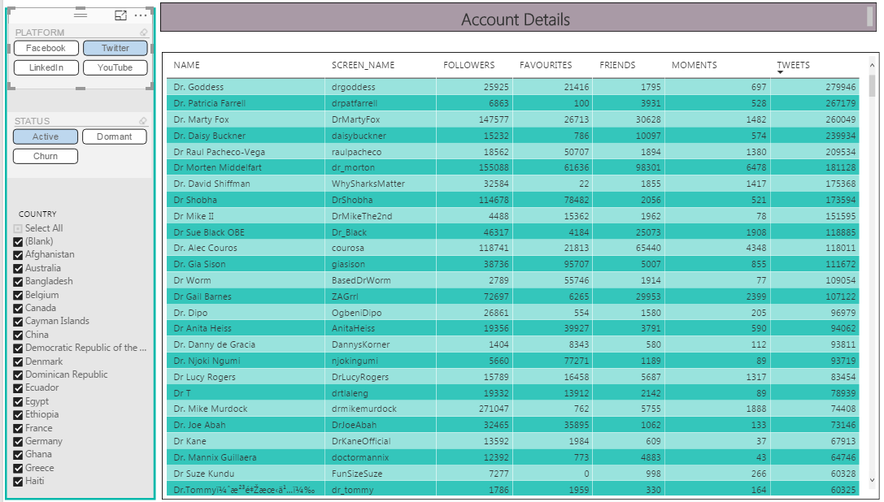
SAMPLE REPORT: ACCOUNT DETAILS

Slide 10
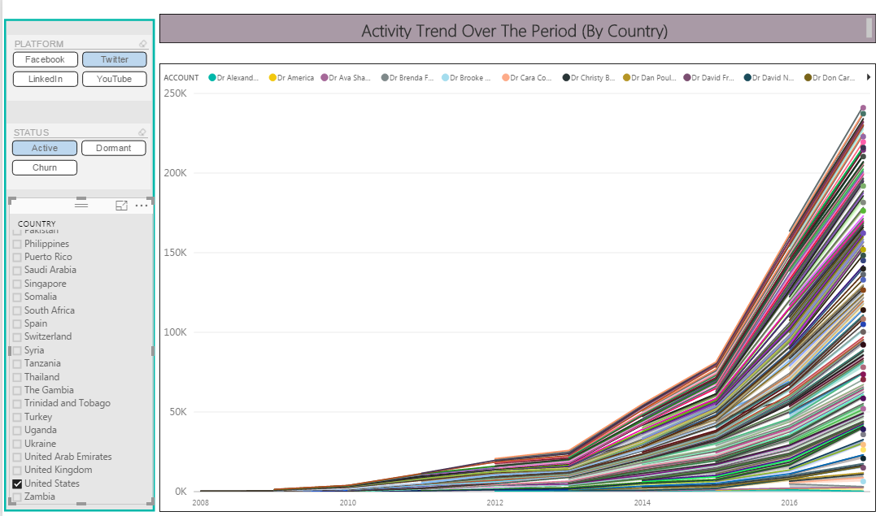
SAMPLE REPORT: ACTIVITY TREND BY COUNTRY

Slide 11
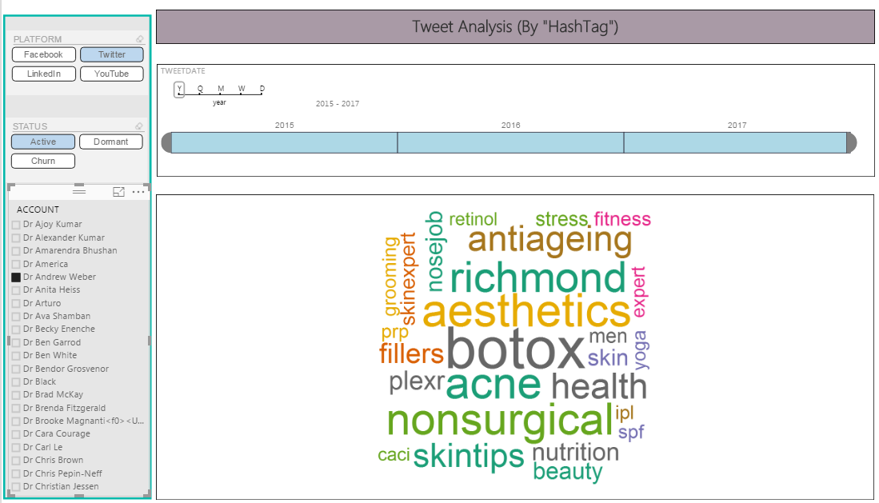
SAMPLE REPORT: TWEET ANALYSIS

Slide 12
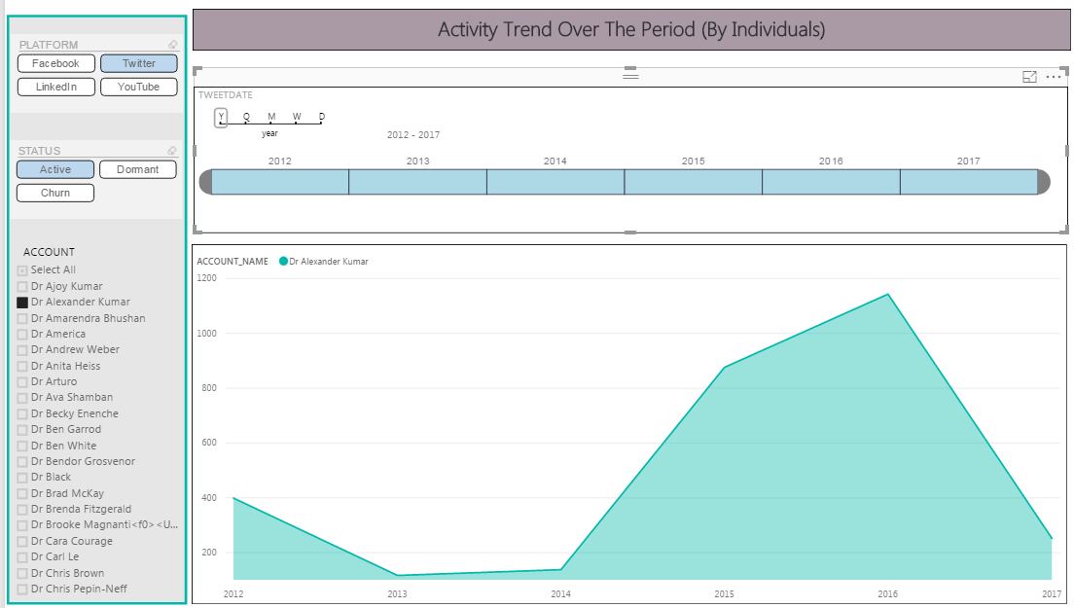
SAMPLE REPORT: ACTIVITY TREND

Slide 13
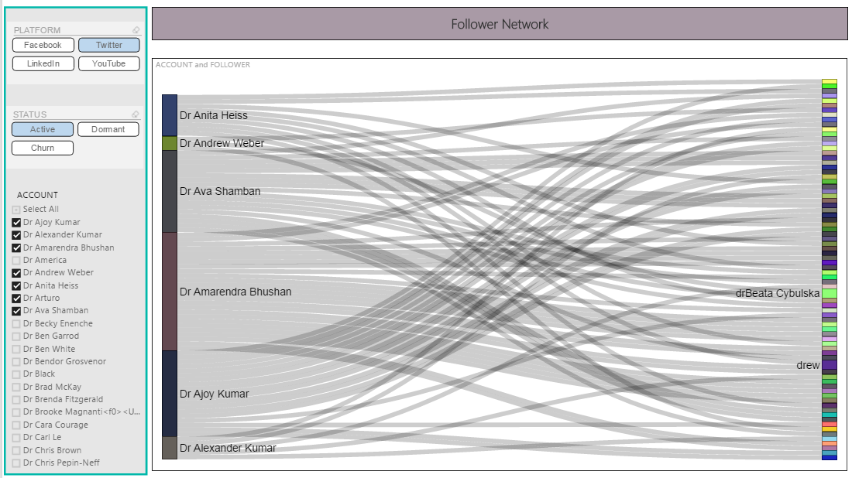
SAMPLE REPORT: FOLLOWER NETWORK

Slide 14
SCOPE OF ENHANCEMENT:
Enrich the physician base including other platforms (e.g., Facebook, YouTube etc. ) and searching different criteria
Master data management
map physicians across different social media
To map to actual physician so that we could find out some concreate information
To eliminate garbage
Sentiment analysis to identify physician’s interest

Slide 15
Thank You

